Slide 1
Conditional Diffusion with Classifier Guidance
Jan Walliser, Sören Toschek

Slide 2
Overview
Problem statement
Reference paper: “Diffusion Models Beat GANs on Image Synthesis”
Classifier Guidance
Classifier Gradient Scaling
Training
Model architecture
Experimental Setup
Results

Slide 3

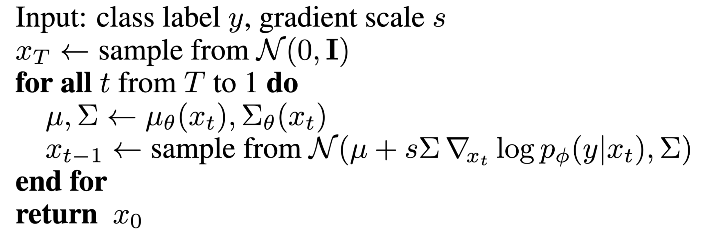
Classifier Guidance
Can be applied during sampling of a diffusion model
predicted mean is shifted towards gradients of classifier
I.e.

Slide 4

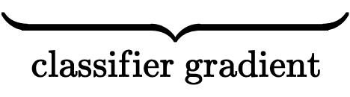
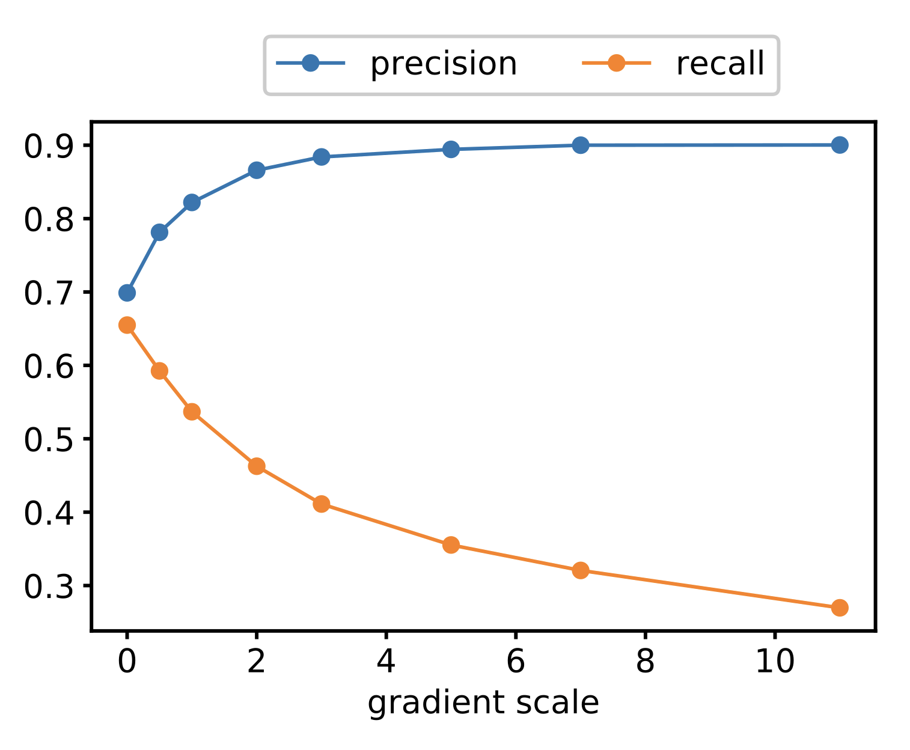
Classifier Gradient Scaling
Multiply gradient of the classifier network by a constant
stronger classifier guidance improves precision, and decreases recall
Ref. 1

Slide 5
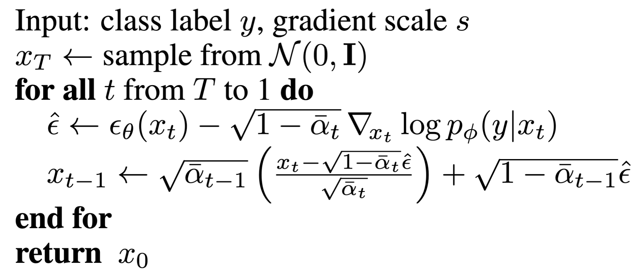
Diffusion Model Architecture

Slide 6

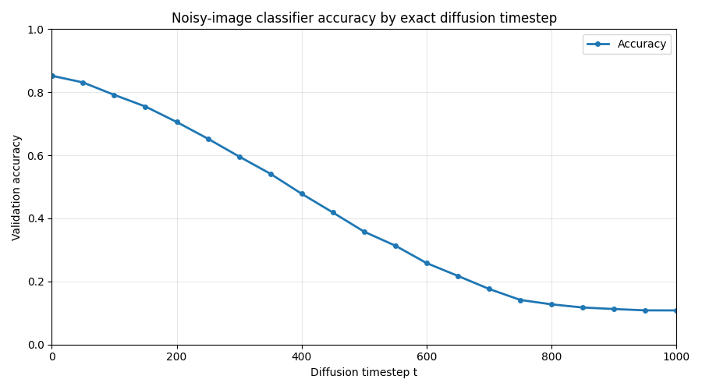
Training / training objective
Use MSE loss:
classifier: 30,480,010 parameters
diffusion-net: 41,412,771 parameters

Slide 7
Classifier architecture
UNet, residual convolutional layer
Classifier architecture:
CNN with skip connections with attention pooling at the end
Attention pooling on 16x16 and 8x8 resolution
map each

Slide 8
Experimental Setup
Dataset:
CIFAR-10
Resolution: 32x32
Evaluated Classes:
airplane (0)
automobile (1)
dog (5)
ship (8)
Sampling Configuration:
1000 generated samples per class
1000 DDPM sampling timesteps
Guidance scales (constant):
s = 0
s = 5
s = 10
Evaluation:
Fréchet Inception Distance (FID)
CIFAR-10 train vs test FID as baseline

Slide 9
Results
FID Results — Constant Guidance Scale
Lower = Better
Class | Baseline | Scale 0 | Scale 5 | Scale 10
airplane | 36.38 | 126.95 | 67.35 | 78.62
car | 26.56 | 138.27 | 49.32 | 48.09
dog | 39.34 | 107.65 | 79.44 | 95.01
ship | 31.05 | 143.17 | 45.67 | 48.97

Slide 10

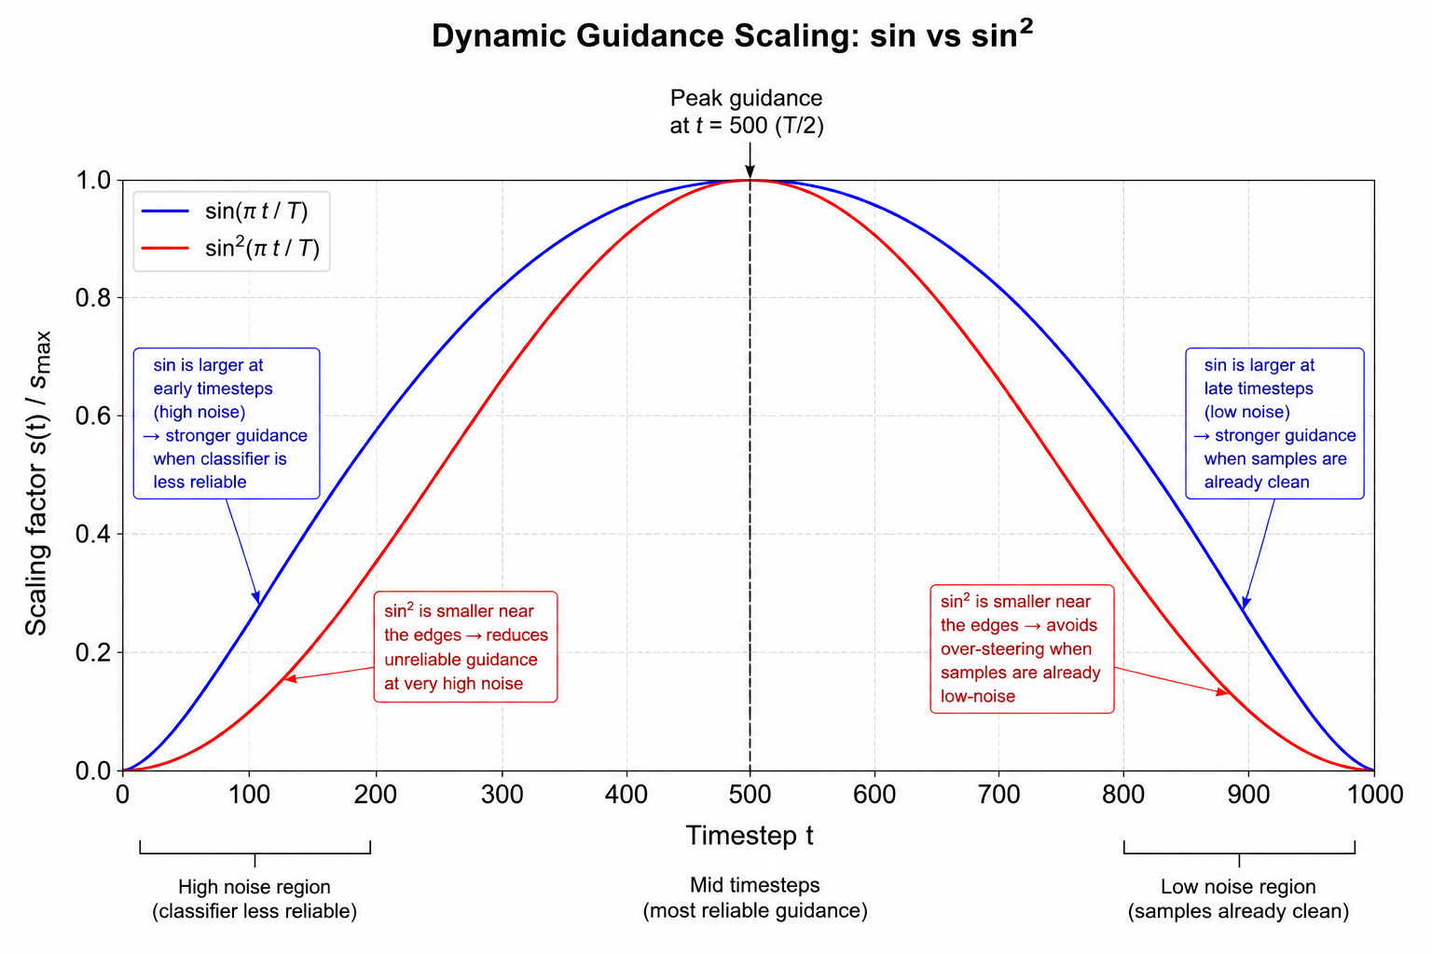
Results
FID Results — Dynamic Guidance Scale
 | Airplane | Ship | Car | Car(sin) | Ship(sin)
Base | 36.38 | 31.05 | 26.56 | 26.56 | 31.05
Const. s=5 | 67.35 | 45.67 | 49.32 | 49.32 | 45.67
Dyn. s=5 | 63.92 | 48.25 | 50.86 | 50.24 | 47.00
Const. s=10 | 78.61 | 48.97 | 48.09 | 48.09 | 48.97
Dyn. s=10 | 71.01 | 46.29 | 46.95 | 47.16 | 47.04

Slide 11
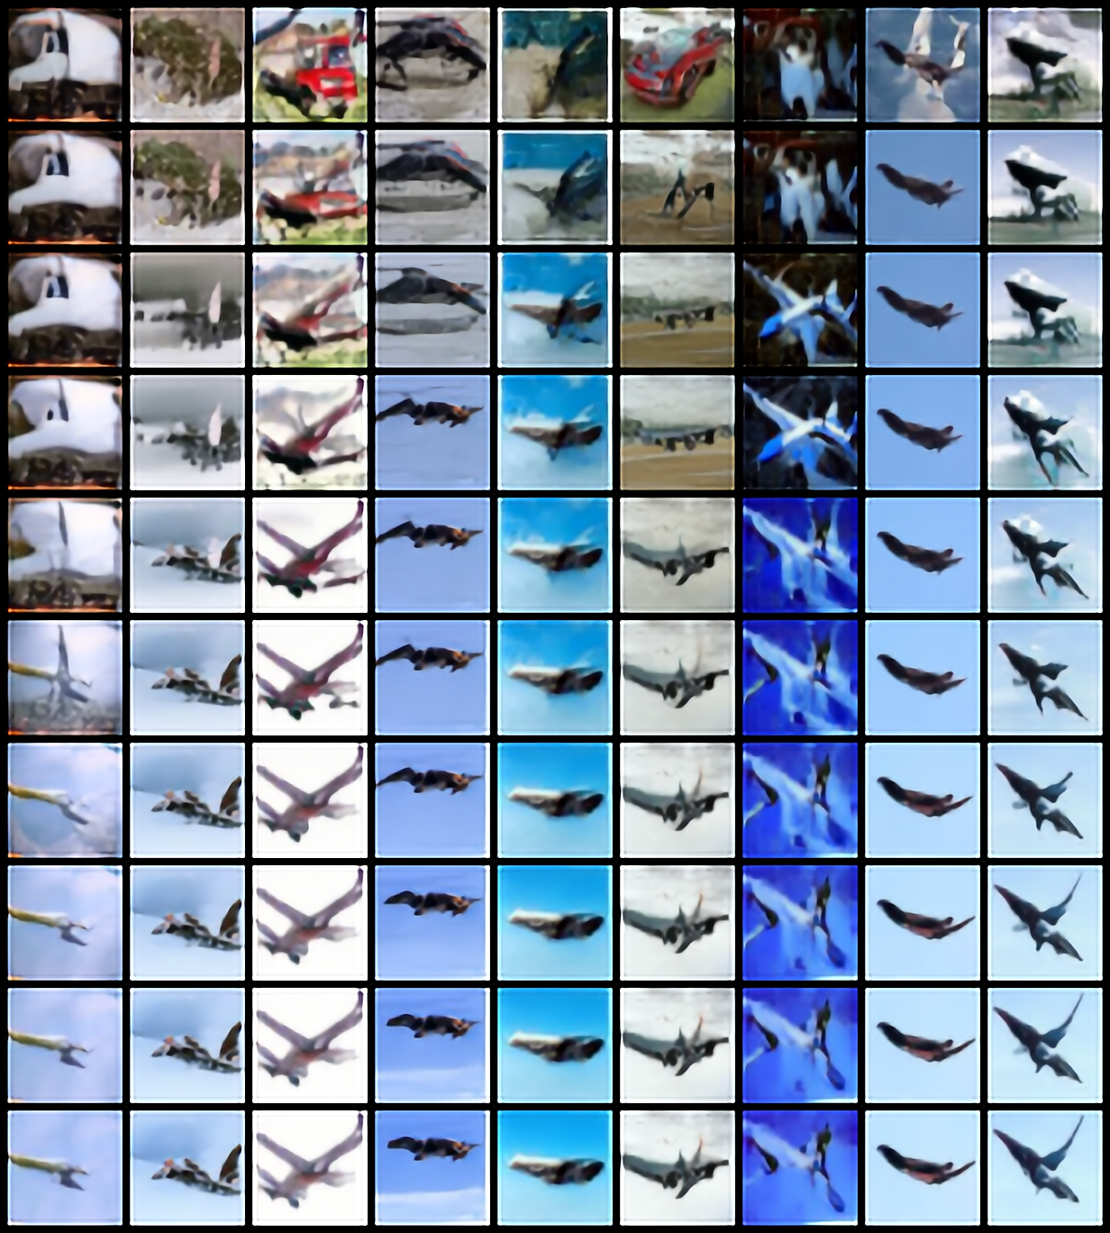
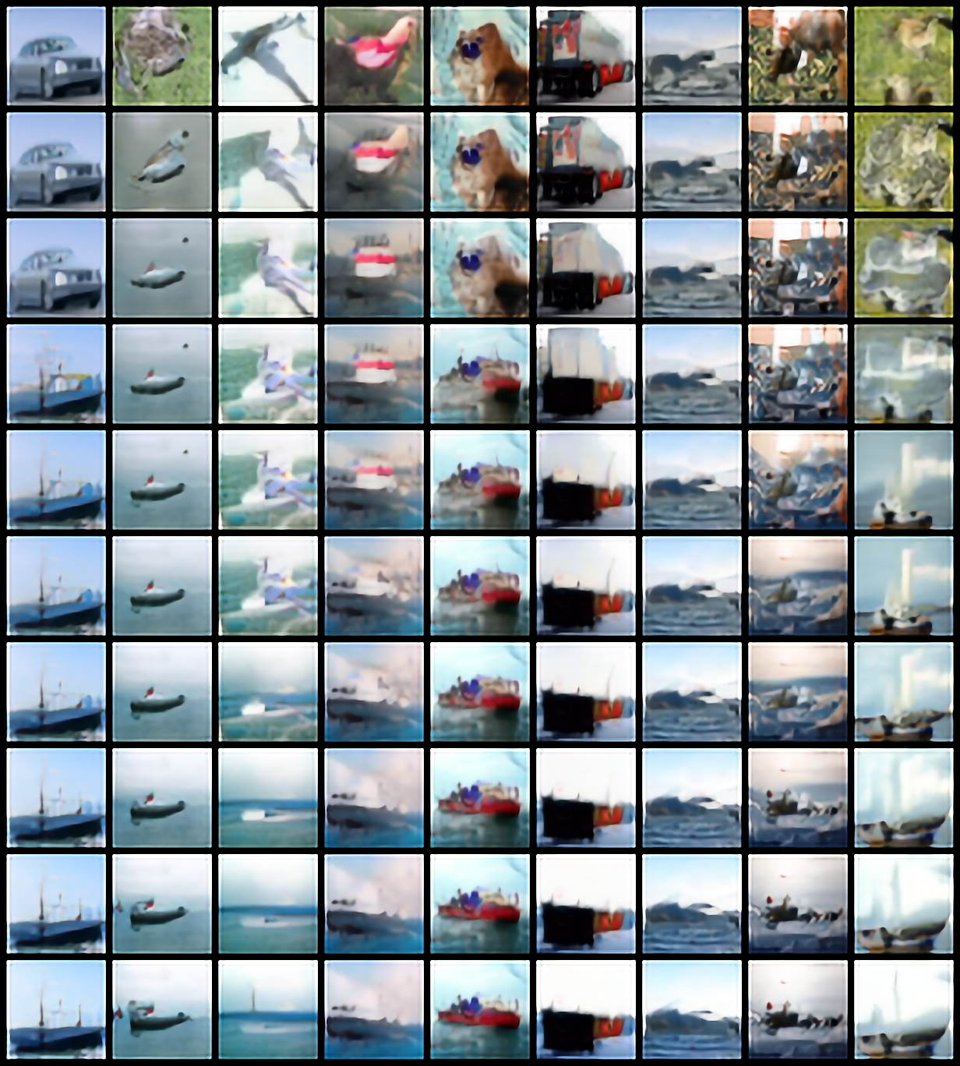
Results

Slide 12
References
Dhariwal et al., 2021, “Diffusion Models Beat GANs on Image Synthesis”
Ho et al., 2020, “Denoising Diffusion Probabilistic Models”
Ho & Salimans, 2022, “Classifier-free Diffusion Guidance”

